Slide 1
Welcome to the world of HHR Multimedia presentation.
Notes:
Welcome slide. Just one click.

Slide 2
Conducted by-
Welcome
To
English Class
Md. Hasan Hafizur Rahman
Lecturer
Department of English
Cambrian School & College
Building-5, Dhaka.
Class-8
English First Paper
Notes:
This slide means introduction of teacher & class.

Slide 3
Beginning
Notes:
Teacher may give the students some time to think about picture, then click for animation.

Slide 4
Our Today’s Lesson is-
The beginning
Unit-5, Lesson-1
Notes:
Lesson declaration.

Slide 5
Learning outcomes
At the end of the lesson, we will be able to learn…
read and understand text through silent reading
ask and answer questions
write answer to questions
write a paragraph
Notes:
All the four skills will be focused in this lesson. If the teacher wants to avoid word meaning option, he may use hyperlink.

Slide 6
Not for the students
Keywords
Teacher may show this option if time may allow. To conduct this portion teacher can show the word first to ask meaning, then he can advance according to animation.
Notes:
To avoid key word option teacher may click hyperlink shown in the learning outcomes slide.

Slide 7
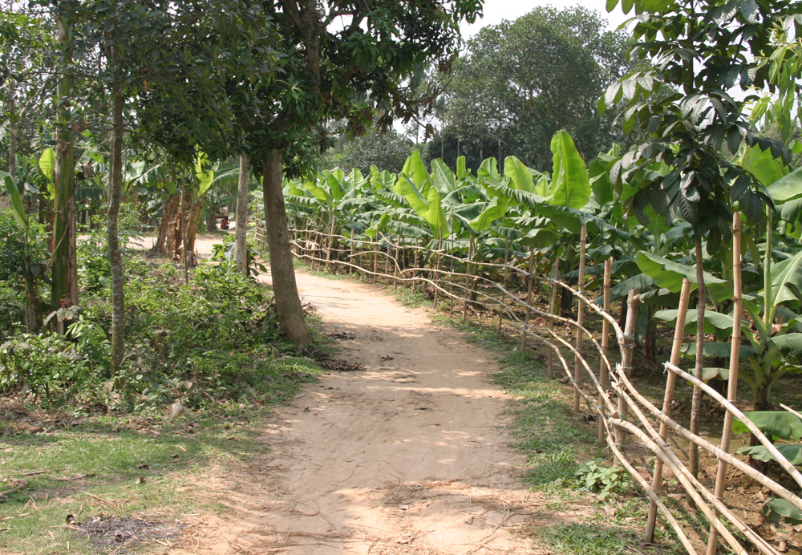
Typical
Meaning: Characteristic/usual
Bahadurpur is a typical village .
Notes:
To conduct this option teacher may show the word first and ask the meaning, then the picture, then meaning and at last the sentence to clear all.

Slide 8
Extra ordinary
Meaning: Unusual/tremendous
Shamima Akter is an extra ordinary woman
Notes:
To conduct this option teacher may show the word first and ask the meaning, then the picture, then meaning and at last the sentence to clear all.

Slide 9
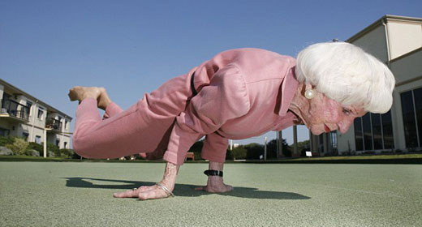
Willpower
Meaning: Confidence/ determination
Everything is possible if your willpower is strong.
Notes:
To conduct this option teacher may show the word first and ask the meaning, then the picture, then meaning and at last the sentence to clear all.

Slide 10
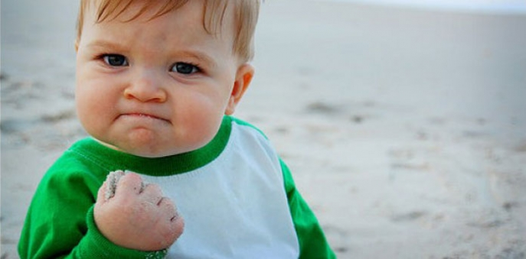
Determination
Meaning: Confidence/ power of mind
Everything is possible if you are determind.
Notes:
To conduct this option teacher may show the word first and ask the meaning, then the picture, then meaning and at last the sentence to clear all.

Slide 11
Aspect
Meaning: Outlook/view/appearance
It is our aspect to make our learning digital.
Notes:
To conduct this option teacher may show the word first and ask the meaning, then the picture, then meaning and at last the sentence to clear all.

Slide 12
Spirit
Meaning: soul/ego
Nothing could defeat her spirit.
Notes:
To conduct this option teacher may show the word first and ask the meaning, then the picture, then meaning and at last the sentence to clear all.

Slide 13
Defying
Meaning: Avoid/disobey
He succeeded defying all the odds of life.
Notes:
To conduct this option teacher may show the word first and ask the meaning, then the picture, then meaning and at last the sentence to clear all.

Slide 14
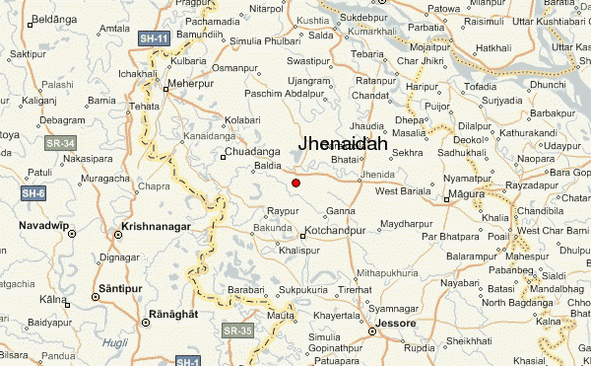
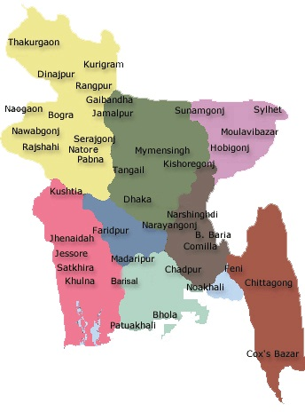
Khulna
Jhenaidah
Dhaka
Notes:
Click middle circle, after a few seconds again click middle circle, then click Jhenaidah to show the map.

Slide 15
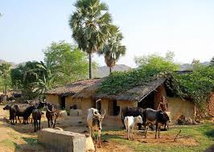
Bhabanipur, a small village in Jhenaidah.
Notes:
Introduction of Bahadurpur.

Slide 16
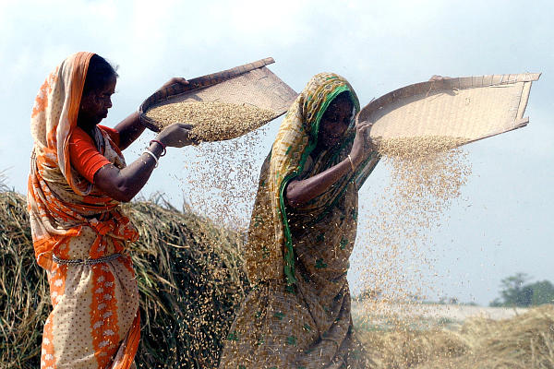
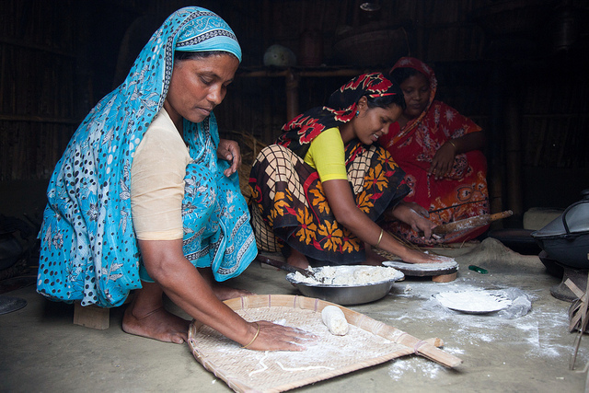
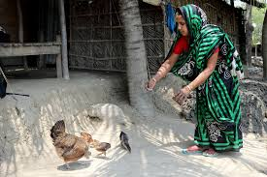
People here spend their day-to-day life mostly working in the fields and doing household works.
Notes:
Textt reading option.

Slide 17
Extra ordinary woman
Ordinary village
Shamima Akter Maya (32)
Notes:
Text placement.

Slide 18
A Read the text and tick the best answers to the following questions.
Shamima’s willpower and determination have made her extraordinary. She has seen the most cruel aspect of life. But the cruelty could not defeat her spirit. She has come out as a winner, defying all the odds of life. Shamima is now 32 years old. She runs a small boutique called ‘Oikko Nari Kollayan Shangstha’ in her village. Let’s hear from Shamima, how she succeeded in setting up her boutique.
Dear students,
Open your text book, page no-49, read silently from (Shamima’s will power and determination-----------setting up her boutique)
Notes:
This is for loud reading.

Slide 19
1 Bhabanipur is a typical Bangladeshi village.
The underlined word means
a unusual. b usual.
c famous. d infamous.
2 Shamima is an extraordinary person.
Here underlined word means
a common. b simple.
c amazing. d normal.
3 People of determination succeed in the long run.
Here underlined word means
a willpower. b weakness.
c strong desire. d wish.
Notes:
Teacher may ask the answer first, then he may advance to check if the students are correct or not.

Slide 20
4 Shamima has faced the most dark aspect of life.
Here the underlined word means
a appearance.
b position.
c characteristics.
d piece.
The tragedy in Shamima’s life could not defeat. her spirit. Here spirit means-
a ghost.
b soul.
c strength.
d wisdom.
Notes:
Teacher may ask the answer first, then he may advance to check if the students are correct or not.

Slide 21
Now complete section B & C from your text book.
Home work
D Write a paragraph about Shamima from your imagination. In your paragraph write what Shamima should do for the good of her own family as well as the other families in the village.
Notes:
To find out the creativity of the students teacher may explain section D.

Slide 22
Verse Universal
Self help is the best help.
Notes:
Advice to the students.

Slide 23
Jajakallahu khayer.

Slide 24
Acknowledgement
We would like to express our cordial gratitude to the Ministry of Education, Directorate of Secondary & Higher Education, NCTB, A2i and the panel of honorable editors ( Md. Jahangir Hasan, Assistant Professor (English) TTC, Rangpur, Ranjit Poddar, Associate Professor (English) TTC, Dhaka, and Urmila Khaled, Assistant Professor (English) TTC, Dhaka, to enrich the contents.

